Slide 1


Weekly Update : Week 19
Ahmad Agus Widodo
PhD Student in Geotechnics Sections
Supervisors:
Dr Truong Le (Geotechnic Sections)
Dr Philippa J Mason (Royal School of Mines)
This PhD is funded by Indonesian Endowment Funds for Education (LPDP)

Slide 2
Outline
01 LiDAR Specification Used by Defra
02 Classification Process

Slide 3
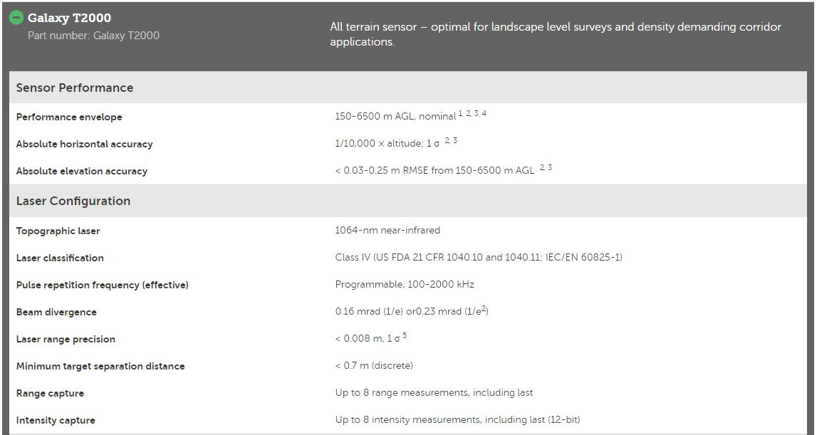
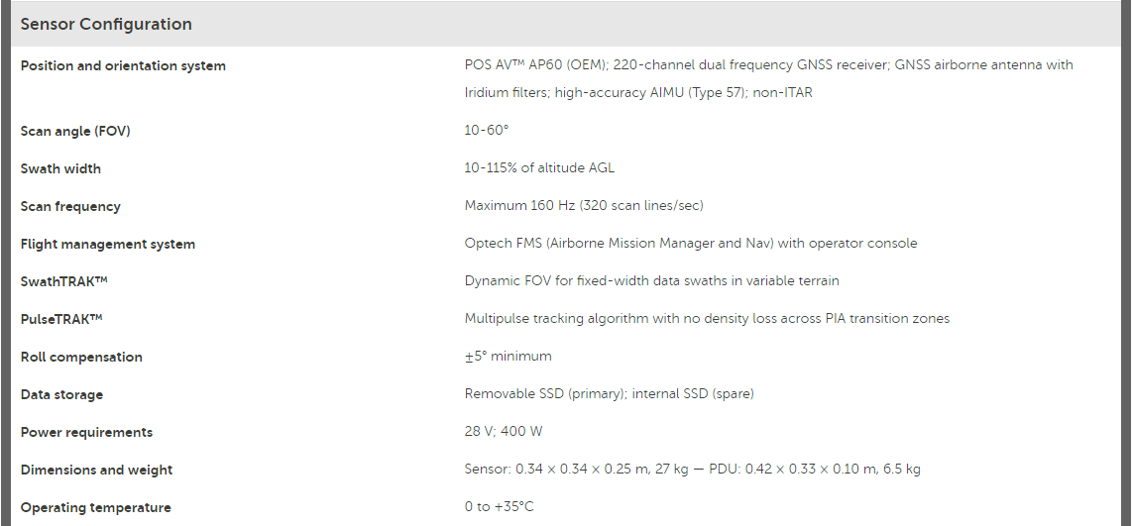
LiDAR Used by Defra
Reference: Galaxy | Teledyne Geospatial (teledyneoptech.com)

Slide 4
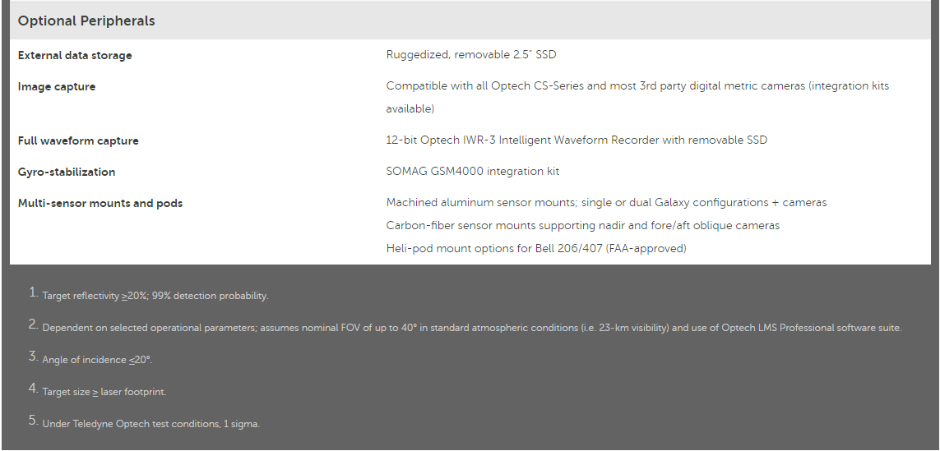
LiDAR Used by Defra
Reference: Galaxy | Teledyne Geospatial (teledyneoptech.com)

Slide 5
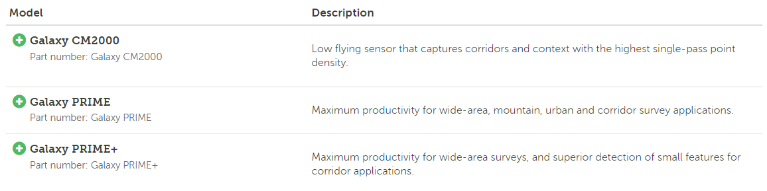
LiDAR Used by Defra
Reference: Galaxy | Teledyne Geospatial (teledyneoptech.com)

Slide 6
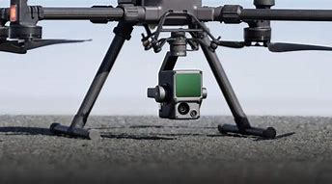
LiDAR Used by Railwork
A Lidar + RGB Solution for Aerial Surveying
The Zenmuse L1 integrates a Livox Lidar module, a high-accuracy IMU, and a camera with a 1-inch CMOS on a 3-axis stabilized gimbal. When used with Matrice 300 RTK and DJI Terra, the L1 forms a complete solution that gives you real-time 3D data throughout the day, efficiently capturing the details of complex structures and delivering highly accurate reconstructed models.
Integrates a Lidar module, an RGB camera, and a high-accuracy IMU
High Efficiency 2 km²covered in a single flight
High Accuracy Vertical Accuracy: 5 cm / Horizontal Accuracy: 10 cm
Point Rate: 240,000 pts/s
Supports 3 Returns
Detection Range: 450 m(80% reflectivity, 0 klx)
DJI Zenmuse L1

Slide 7
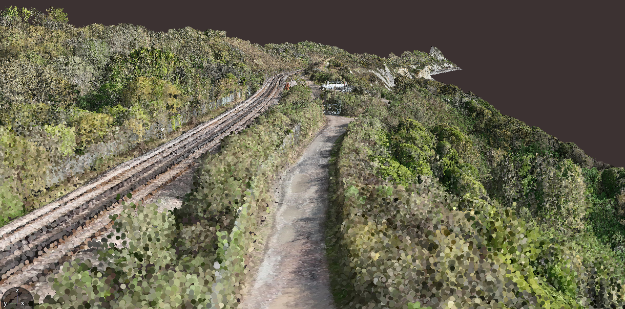
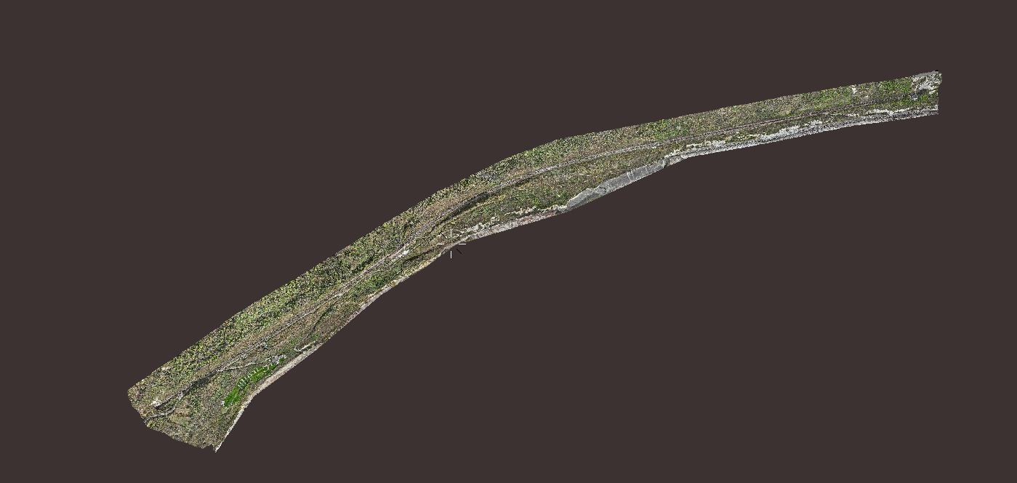
LiDAR Used by Railwork
All Segments
Detailed 3D Point Cloud Data
Data Source: Railwork
Location : Folkstone
Time : 16 March 2024
Tool : Dizplaz

Slide 8
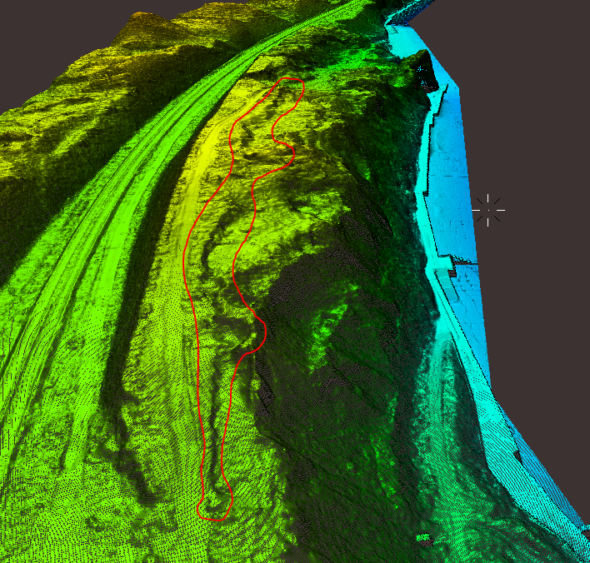
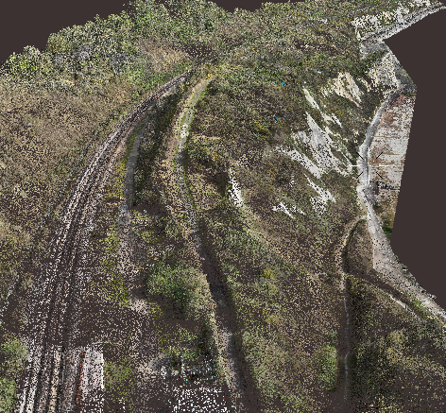
LiDAR Used by Railwork
3D DTM Data
3D Point Cloud Data

Slide 9
Classification Process
References:
2D to 3D Label Propagation for Object Detection in Point Cloud
3D Point Cloud Analysis and Classification in Large-Scale Scene Based on Deep Learning
Enrich Features for Few-Shot Point Cloud Classification
Weakly-Supervised Point-Cloud Classification in Transmission Engineering
Intelligent classification of point clouds for indoor components based on dimensionality reduction
Comparison of 3D Rice Organs Point Cloud Classification Techniques

Slide 10
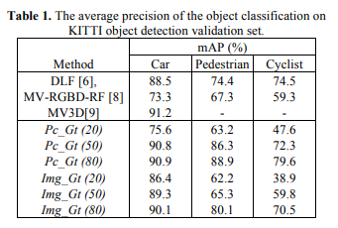
Summary from References
Lertniphonphan, K., Komorita, S., Tasaka, K., & Yanagihara, H. (2018, July). 2d to 3d label propagation for object detection in point cloud. In 2018 IEEE International Conference on Multimedia & Expo Workshops (ICMEW) (pp. 1-6). IEEE.
Manual Labelling | Deep Learning | Data | Result
Time-consuming, costly, Hard to Identify the object | Fast and Accurate Decision | KITTI Dataset containing LiDAR Point Cloud, RGB Images, velodyne-to-camera calibration matrix, 2D bounding box of objects in images, 3D bounding box of objects in point cloud
the reflected point is based on the surface reflectivity. Parts of an object, such as car mirror, do not reflect the emitted light pulse and make the object point cloud disconnected. | Combining data information of point cloud and image to increase semantic segmentation of the sparse point cloud
Objects with few points do not have enough semantic information to identify their category | R-CNN for training method |  | DLF = Decision Level Function MV-RGBD-RF = Multiview-RGBD-Random Forest MV3D = Multiview 3D Object Pc-Gt = Point cloud – Ground Truth Img-Gt = Image – Ground Truth
The range of a single frame point cloud is limited and shorter than the range of an image.

Slide 11
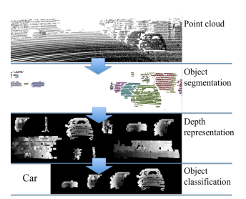
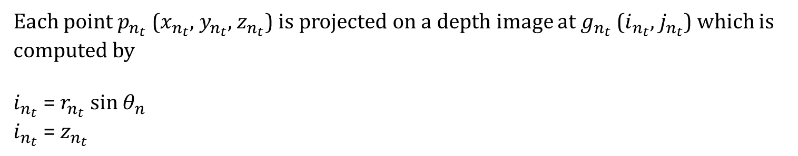
Method
1. Ground plane is removed using RANSAC
2. the remaining points are clustered into small groups by the distance constraint. In the training process, our proposed framework finds the matching area within the 2D bounding box using EUCLIDEAN CLUSTERING
3. The matched point cluster is labelled as the corresponding object in the image. Since a single scan point cloud contains distance information of an object on a side that faces the sensor, we emphasize the information by projecting distance information on a depth image.
4.The classifiers are trained by the depth images and used to identify object point cloud category. We compare the classification accuracy from the different training data as mentioned before. The intensity of the depth image represents the distance between a point and projection plane.
Each point $p_{n_{t}}$ ($x_{n_{t}}$, $y_{n_{t}}$, $z_{n_{t}}$) is projected on a depth image at $g_{n_{t}}$($i_{n_{t}}$, $j_{n_{t}}$) which is computed by
$i_{n_{t}}$ = $r_{n_{t}}$ sin ${\text{θ}}_{n}$
$i_{n_{t}}$ = $z_{n_{t}}$

Slide 12
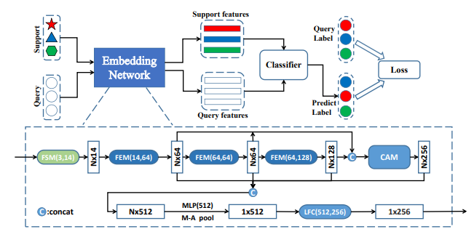
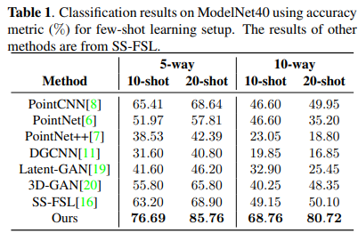
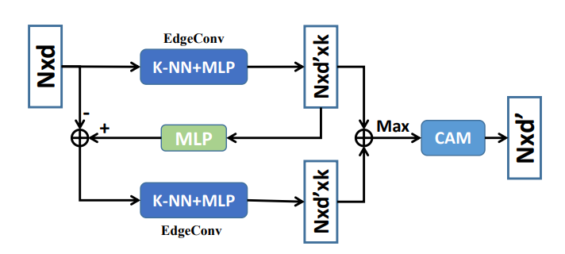
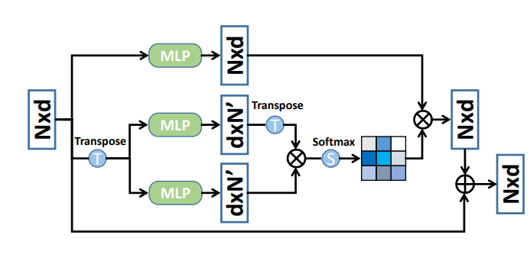
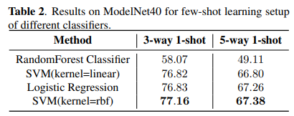
Reference:
Feng, H., Liu, W., Wang, Y., & Liu, B. (2022, May). Enrich features for few-shot point cloud classification. In ICASSP 2022-2022 IEEE International Conference on Acoustics, Speech and Signal Processing (ICASSP) (pp. 2285-2289). IEEE.
Proposed Method
a novel few-shot point cloud classification method to classify new categories given a few labelled samples
apply the feature supplement module to enrich the geometric information of points and then aggregate multi-scale features through the channel-wise attention module while reducing the computational complexity
introduce a classifier to classify the point cloud features under the few-shot learning setup to predict its label.
Result:
MLP = Multi-Layer Perceptron
FEM = Feature Extraction Module
CAM = Channel-wise Attention Module
SS-FSL = Self-supervised few-shot lear

Slide 13
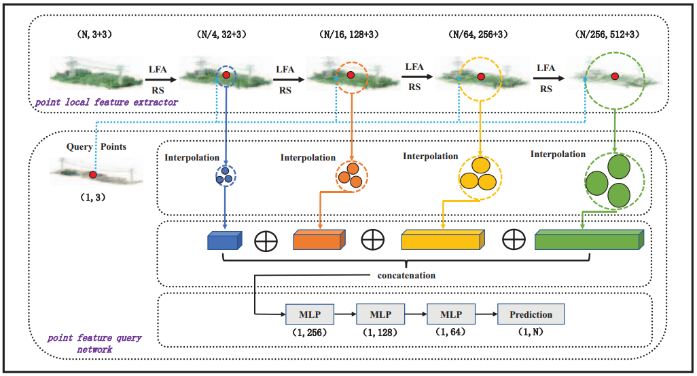
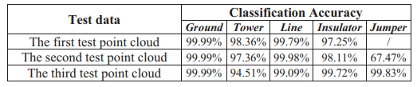
Reference:
Changqing, D. U., Peng, Y. U., Zhou, F. A. N., Hongping, X. I. E., Chao, H. A. N., Ziqiang, T. A. N. G., ... & Luyang, Y. A. N. (2023, April). Weakly-Supervised Point-Cloud Classification in Transmission Engineering. In 2023 Asia-Pacific Conference on Image Processing, Electronics and Computers (IPEC) (pp. 163-168). IEEE.
Outline
The paper focuses on how to solve the problem of lacking sample label information in a large-scale 3D point cloud semantic segmentation task
Proposed Method: Semantic Query Network (SQN) SQN network consists of two main parts: local feature extractor and point feature query network.
Method
Result

Slide 14
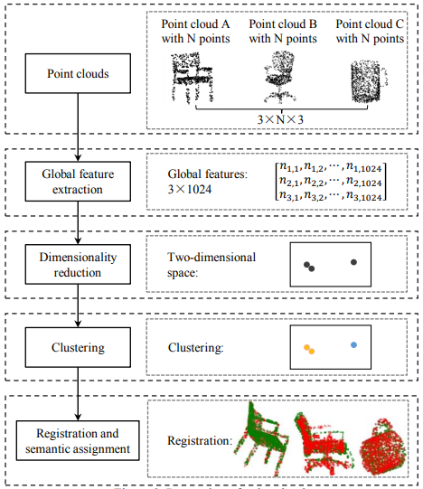
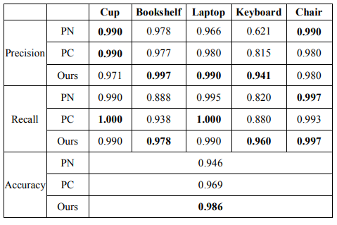
Reference:
Yang, H., & Wu, H. (2020, June). Intelligent classification of point clouds for indoor components based on dimensionality reduction. In 2020 5th International Conference on Computational Intelligence and Applications (ICCIA) (pp. 89-93). IEEE.
Outline
Method
Result
Proposing method for indoor component clustering
Utilising t-SNE (t-Distributed Stochastic Neighbour Embedding) and DBSCAN (Density-based Spatial Clustering With Application of Noises) in global feature extraction

Slide 15
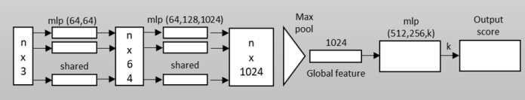
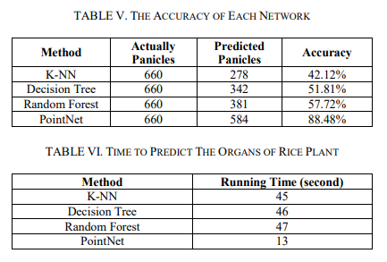
Reference:
Rungyaem, K., Sukvichai, K., Phatrapornnant, T., Kaewpunya, A., & Hasegawa, S. (2021, November). Comparison of 3D Rice Organs Point Cloud Classification Techniques. In 2021 25th International Computer Science and Engineering Conference (ICSEC) (pp. 196-199). IEEE.
Outline
Method
to evaluate and contrast automated 3D rice plant organ classification approaches in order to determine the optimum method for classifying rice organs.
two approaches for classifying rice organs in this study. Tensor based classification is the first method. The second technique is PointNet. In comparison, the PointNet was the most successful for classifying rice organs and spent the least amount of time.
Result

Slide 16
Reference:
Chen, L., Zhang, Y., Lin, Y., Jiang, M., Huang, Y., & Lei, Y. (2021, August). Consistency-based semi-supervised learning for point cloud classification. In 2021 4th International Conference on Pattern Recognition and Artificial Intelligence (PRAI) (pp. 440-445). IEEE.
Aspects

Slide 17
Reference:
Zaydie, A. H. B., Low, M. Y. H., & Lin, W. (2023, December). Perception Pipeline of Autonomous Mobile Robots Using 3D Point Cloud Classification. In 2023 IEEE International Conference on Service Operations and Logistics, and Informatics (SOLI) (pp. 1-7). IEEE.
Aspects

Slide 18
Reference:
Wang, X., Fan, X., & Zhao, D. (2020, December). A semantic labeling framework for ALS point clouds based on discretization and CNN. In 2020 IEEE International Conference on Visual Communications and Image Processing (VCIP) (pp. 58-61). IEEE.
Aspects

Slide 19
Reference:
Li, J., Zhang, W., Diao, W., Feng, Y., Sun, X., & Fu, K. (2021). CSF-Net: Color spectrum fusion network for semantic labeling of airborne laser scanning point cloud. IEEE journal of selected topics in applied earth observations and remote sensing, 15, 339-352.
Aspects

Slide 20
Reference:
Qiang, X., He, W., Chen, S., Lv, Q., & Huang, F. (2023). Hierarchical Point Cloud Transformer: A Unified Vegetation Semantic Segmentation Model for Multisource Point Clouds Based on Deep Learning. IEEE Transactions on Geoscience and Remote Sensing, 61, 1-16.
Aspects

Slide 21
Reference:
Wang, L., Meng, W., Xi, R., Zhang, Y., Ma, C., Lu, L., & Zhang, X. (2019). 3D point cloud analysis and classification in large-scale scene based on deep learning. IEEE access, 7, 55649-55658.
Aspects

Slide 22
Consistency-Based Semi-supervised Learning for Point Cloud Classification
Perception Pipeline of Autonomous Mobile Robots using 3D Point Cloud Classification
A semantic labelling framework for ALS point clouds based on discretization and CNN
CSF-Net: Colour Spectrum Fusion Network for Semantic Labeling of Airborne Laser Scanning Point Cloud
Hierarchical Point Cloud Transformer: A Unified Vegetation Semantic Segmentation Model for Multisource Point Clouds Based on Deep Learning

